Slide 1

A Seminar On “Vehicle Dipper Automatic Controller”
Presented by
Mr. Rohit Shinde
Roll No. [TE-52]
Mr. Sahil Pawar
Roll No. [TE-38]
Mr. Om Kadhekar
Roll No. [TE-35]
Under the Guidance of,
Prof. Rekha Kadam
Department of Electronics and Telecommunication Engineering
Modern Education Society’s College of Engineering,Pune-01
Academic Year 2020-21
Notes:
We designed this template so that each member of the project team has a set of slides with its own theme where he/she can present their research. Members, here’s how you add a new slide to just your set:
Mark where you want to add the slide: Select an existing one in the Thumbnails pane, click the New Slide button, then choose a layout.
The new slide gets the same theme as the previous one you selected.
Careful! Don’t annoy your fellow presenters by accidentally changing their themes. That can happen if you choose a theme Variant from the Design tab, which changes all of the slides in your presentation to that look.

Slide 2
Introduction
Literature Survey
Objectives
Need Of Project
Block Diagram
Circuit Diagram
Electronic hardware/software components
Specifications
Flow Of Work
Project Application
Advantages
Conclusion
References

Slide 3
Introduction
Now a days the number of vehicle on road is increasing drastically and number of accidents on road are also increasing. Especially at night most of the accidents are occurred due to dazzling of headlight. While driving at night the headlight beam of coming vehicle is directly affects the driver’s eye and eye gets blur, it takes 3 to 8 sec to recover to its normal vision.
Automatic dipper light control is a system which automatically changes the headlight from upper to dipper beam by sensing the headlight of the coming vehicle .To overcome these problems a new circuit which will directly operate the headlight beam

Slide 4
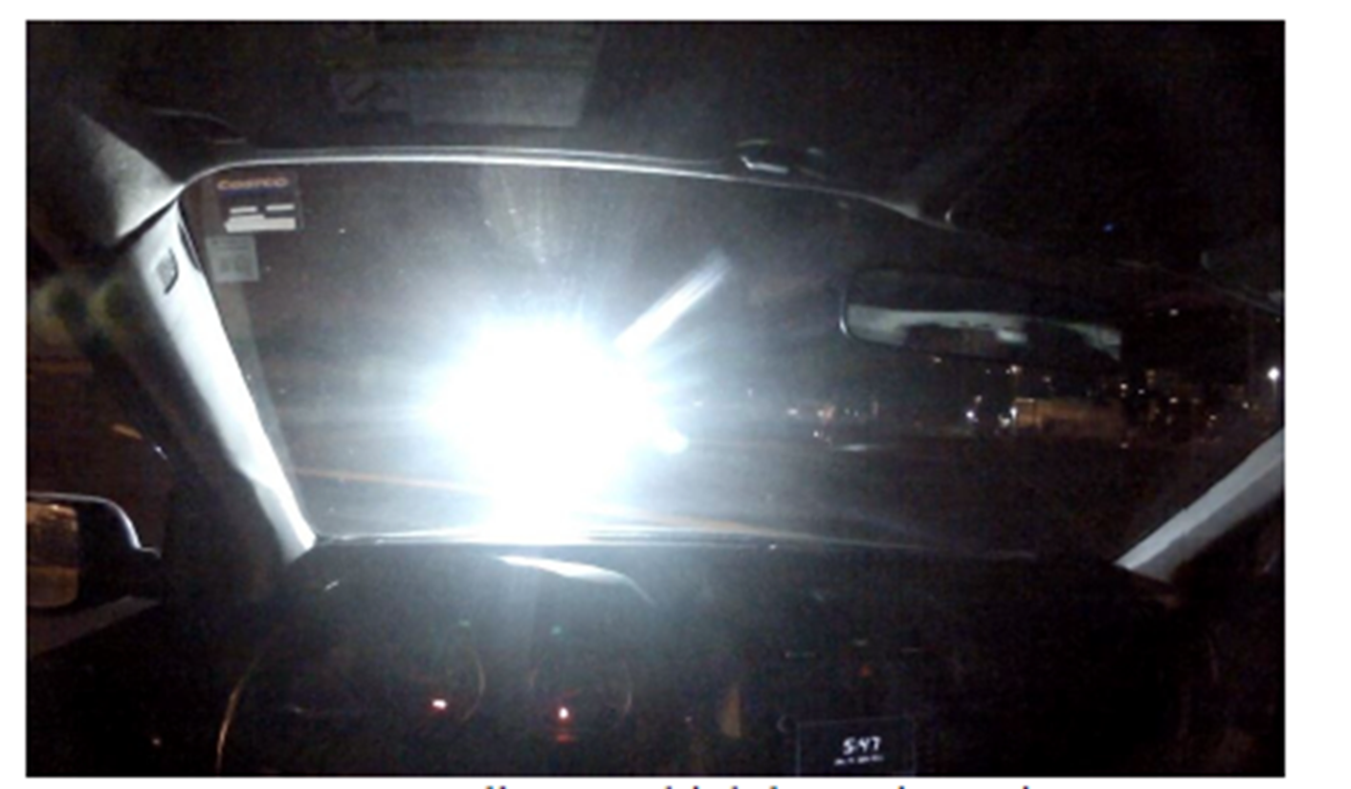
There is common problem is occurred while driving in cities, streetlights or lights of shops are affecting on the system and reduce the life of relay and headlamp. To reduce that, the manual mode which is already present in vehicle is used .
Fig.1:

Slide 5
Literature Survey
The author observed that the technology of pneumatics plays a major role in the field of automation and modern machine shops and space robots.. The aim is to design and develop a control system based smart electronically controlled automotive bumper activation and automatic braking system is called AUTOMATIC PNEUMATIC BUMPER AND BREAK ACTUATION BEFORE COLLISION. This project consists of IR transmitter and Receiver circuit, Control Unit, Pneumatic bumper system and pneumatic braking system. The IR sensor are used to senses the obstacle. If there is any obstacle closer to the vehicle (within 2-3 feet) the control signal is transferred to the bumper activation system and also pneumatic braking system simultaneously. The pneumatic bumper and braking system is used to product the man and vehicle. This bumper and braking system is only operate if the vehicle speed above 30-40 km per hour. This speed of vehicle is sensed by the sensor and this signal is transferred to the control unit and pneumatic bumper and braking activation system.[1]

Slide 6
There are two consumer evaluation programs of vehicle frontal crashworthiness in the United States. The National Highway of Traffic Safety Administration (NHTSA) gives occupant protection ratings of 1 to 5 stars for the drivers based on vehicle performance in a full-width test into a rigid wall at 35 mi/h (56 km/h). The Insurance Institute for Highway Safety (IIHS) assigns vehicle ratings of good, acceptable, marginal, or poor based on performance in a 40 mi/h (64 km/h) test in which 40% of the vehicle front impacts a deformable barrier. These programs were introduced, structural and restraint system designs have very good improved substantially, and high-test performance now is treated as a de facto standard. Among vehicles rated in the IIHS frontal offset test between January 2005 and May 2008, 85% received good ratings, with the rest receiving the second highest rating of acceptable. In this NHTSA’s frontal Car Assessment Program (NCAP), 95% of model year 2008 vehicles achieved a 4- or 5-star rating for both the driver and right front passenger.[2]
In this paper, the need for safety of vehicles by reducing the impact of crash by applying a smooth or partial braking with the help PIC 16F877a micro controller is proposed. The driver’s risk of sensing the object from a particular distance and not able to notice within the certain limit such conditions are occurs while designing this work. Once the similar situation will be faced to acceleration of the vehicle will be directly controlled without any disturbing the safe throttle (actuation mechanism) of the vehicle, the designed machine itself takes the control of acceleration pedal if the brake is not applied within the predetermined distance.[3]

Slide 7
Objectives
to detect upcoming vehicle using IDR sensor
to automatic change mode of headlight from upper to dipper
to reverse the mode of headlight as soon as upcoming vehicle passes away

Slide 8
Need Of Project
To reduce the number of increasing accidents in day to day life.
Avoid the visibility problem while driving during night.
Save life

Slide 9
Block Diagram
block diagram we present an headlight control system for smart vehicle.
POWER SUPPLY the voltage applied at the input terminal is 7 volts. As The minimum dropout voltage is 2v for IC 7805.
LDR sensor
Here input energy source is selected using LDR system.
ATMEGA 16
8 bit microcontroller of Atmel’s Mega AVR family. Is RISC&CISC architecture with 131 powerful instructions. Most of the instructions execute in one machine cycle
RELAY is been used as the connector between upper
and dipper.
HEADLIGHT

Slide 10
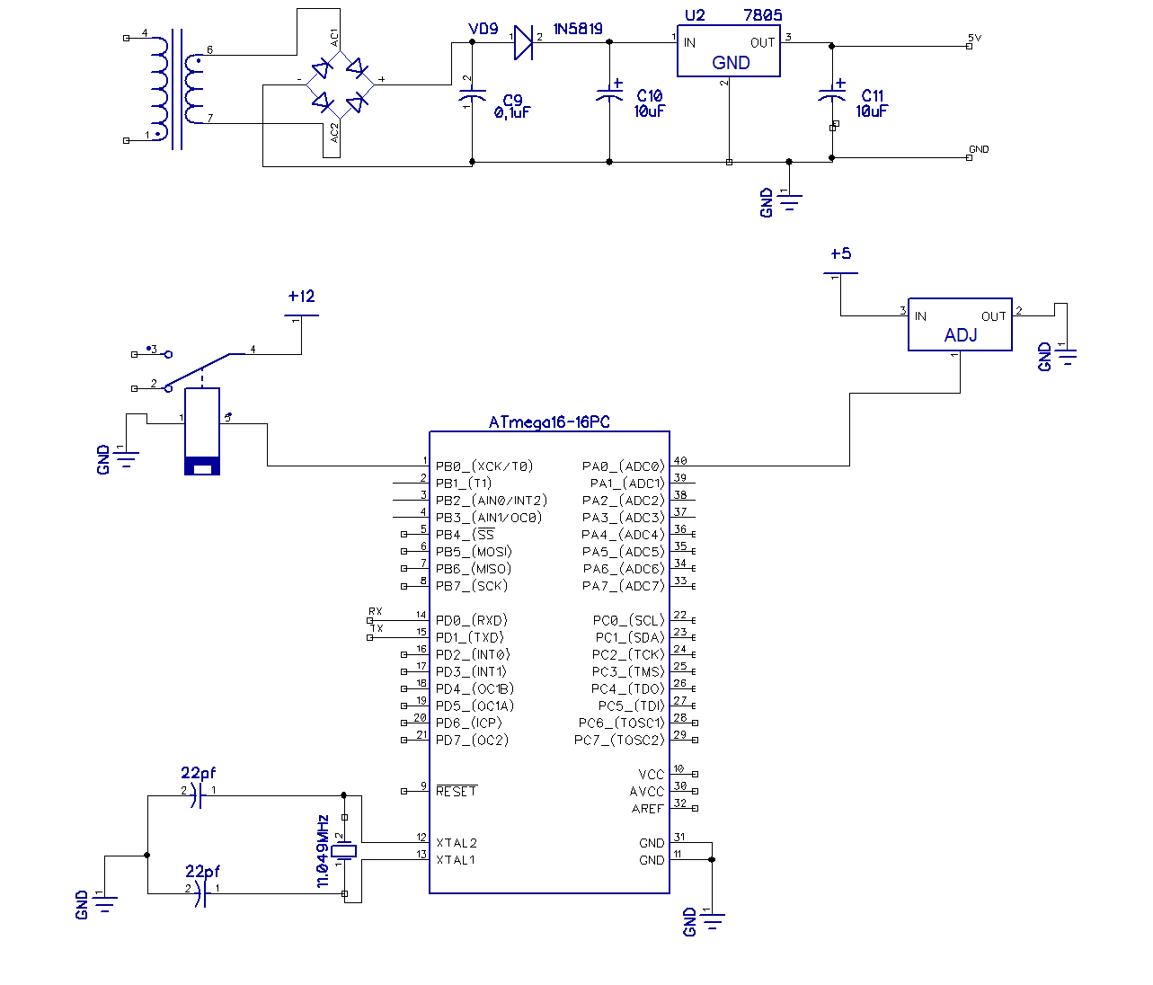
Circuit Diagram:
:

Slide 11
Electronic hardware/software components
Atmega 16
LDR sensor
Relay
Power Supply
DIPTRACE
ISP PROG
AVR STUDIO

Slide 12
Specifications
Power Supply
The bridge rectifier and capacitor I/p filter produce an unregulated DC voltage which is applied at the I/P of 7805.
The minimum dropout voltage is 2v for IC 7805, the voltage applied at the input terminal should be at least 7 volts .
C1 (1000 µf / 65v)is the filter capacitor .
C2,C4 (0.1uF ceramic),C3 (220uF/25V electrolyte capacitor) is to be connected across the regulator to improve the transient response of the regulator.
Assuming the drop out voltage to be 2 volts, the minimum DV voltage across the capacitor C1 should be equal to 7volts (at least).

Slide 13
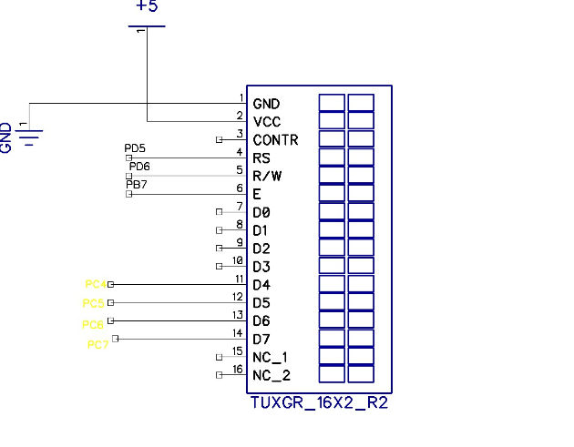
Current Consumption:
LCD has 2 Power Sources
1. VCC and GND are at 1 and 2 NO. Pins of LCD. Used to drive the LCD 3mA current consumption.
2. VCC and GND is at 15 and 16 NO. pins of LCD used to drive the backlight of LCD 100 mA current
Total current consumption = 3mA + 100mA = 103 mA
So, in order to reduce the current requirement, we are connecting a 330-ohm resistance in series with the backlight pin VCC. This reduces the current consumption (100mA / 330ohm =0.303 mA).
Therefore, new total current consumption = 0.303mA

Slide 14
ATMEGA16 Controller:
ATmega16 is an 8-bit high performance microcontroller of Atmel’s Mega AVR family with low power consumption.
Atmega16 can work on a maximum operating frequency of 16MHz.
Operating Voltages: 4.5 - 5.5V for ATmega16
Speed Grades: 0 - 16 MHz for ATmega16

Slide 15
Flow Of Work
NO YES
START
INIT HW & SW
SWITCH TO UPPER
READ SENSOR VALUE
END
SWITCH TO DIPPER
IF L>T1

Slide 16
Project Application
Streetlights
Railways
Bus
Private apartments

Slide 17
Advantages
More Convenient
No manual Control
More Reliable
Save life
More user Friendly
Reduce accidents

Slide 18
Conclusion
Automatic dipper provides better safety at nighttime and drivers can drive comfortably and reach their destination safely. There are two modes provided viz. automatic and manual mode. While driving in the cities there are light everywhere which can affect the working of the device at that time the mode can shift to manual mode to avoid flickering of the headlight. When both the vehicles were fitted with the “Automatic Dipper” then both the vehicles dip the headlight beam of each other efficiently. Main components help to run the circuit are easily available and
are also cheap. The circuit is compatible with any vehicle and does not require any other supply, it can efficiently work on battery fitted in the vehicles. Therefore, the installation of this safety system in each vehicle give safety at night driving, increase comfort level of driver and decrease the road accidents.

Slide 19
Reference
[1] Dr. P. Poongodi PPG Institute of Technology, Coimbatore, Tamil Nadu, INDIA – 641012. Mr. P. Dineshkumar, Karpagam University, Coimbatore, Tamil Nadu, INDIA – 641021.
[2] Takahiro Wada “A Deceleration control method of automobile for collision avoidance based on driver perceptual risk” IEEE international Conference on Smart Robots and Systems, Oct 4881-4886
[3] Matthew L. Brumbelow David S. ZUBY Institute of Highway Safety United States Paper No. 09-0257 “IMPACT AND INJURY PATTERNS IN FRONTAL CRASHES OF VEHICLES WITH GOOD RATINGS FOR FRONTAL CRASH PROTECTION”

Slide 20
THANK YOU!!

